Slide 1
Kepler
Design and UI
Gene Olafsen

Slide 2



Recommendation Engine Objective
Configuration
Person Profile Data
Product Data
Configuration

Slide 3
Sample Data sets
TMDB 5000 Movie Dataset | Kaggle
The Indian Movie Database | Kaggle
TED Talks | Kaggle

Slide 4
Object model
App
1-* Session
ConfigMgr
Audit
1-* Message
1-* DataFile
1-* WorkingColumn
1-*CombineColumn
Transform
1-* TransformInstruction
Analyze
1-* VectorizeInstruction
1-* SparseStack
Recommend
RecommendColumn

Slide 5
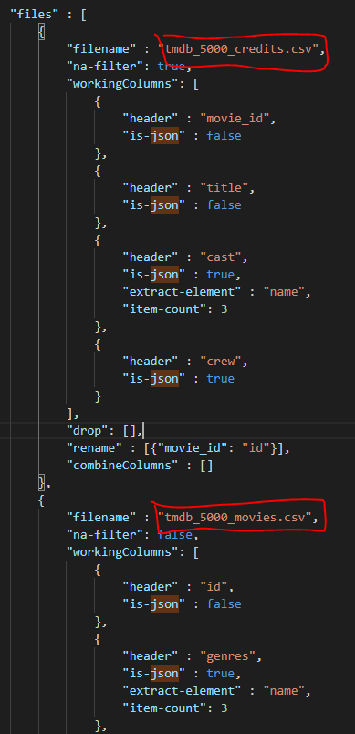

COnfiguration - multiple file source
tmdb_5000_credits.csv
tmdb_5000_movies.csv

Slide 6
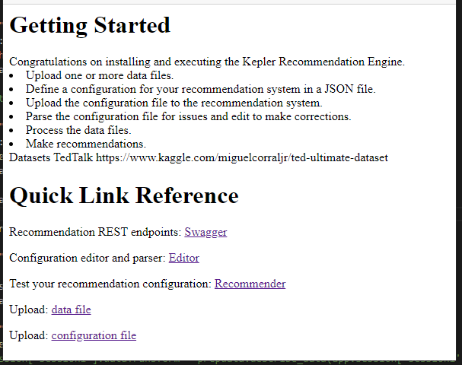
Welcome Page

Slide 7
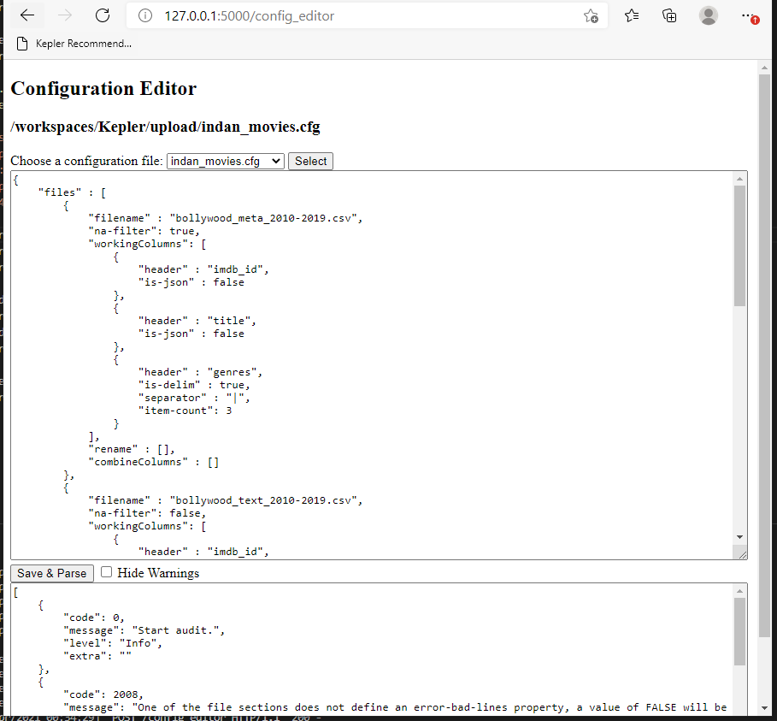
Configuration Editor

Slide 8
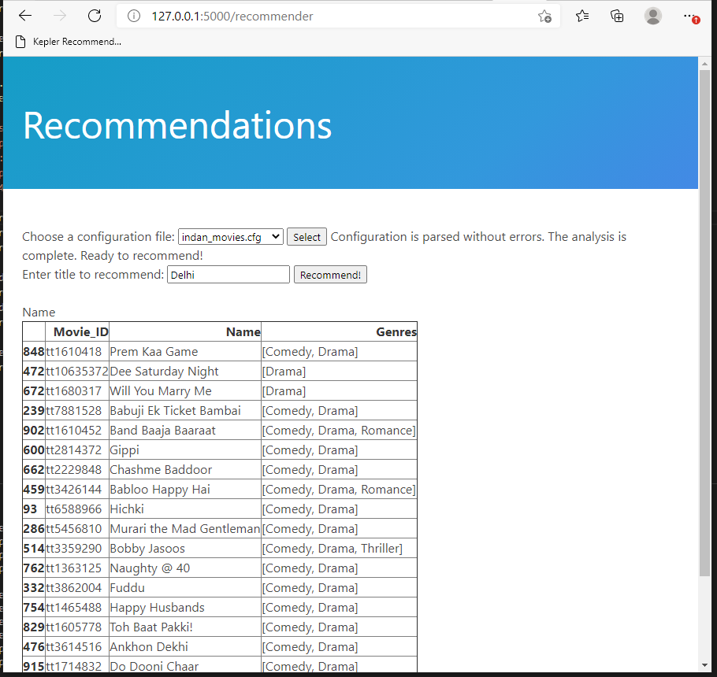
Recommender Page

Slide 9
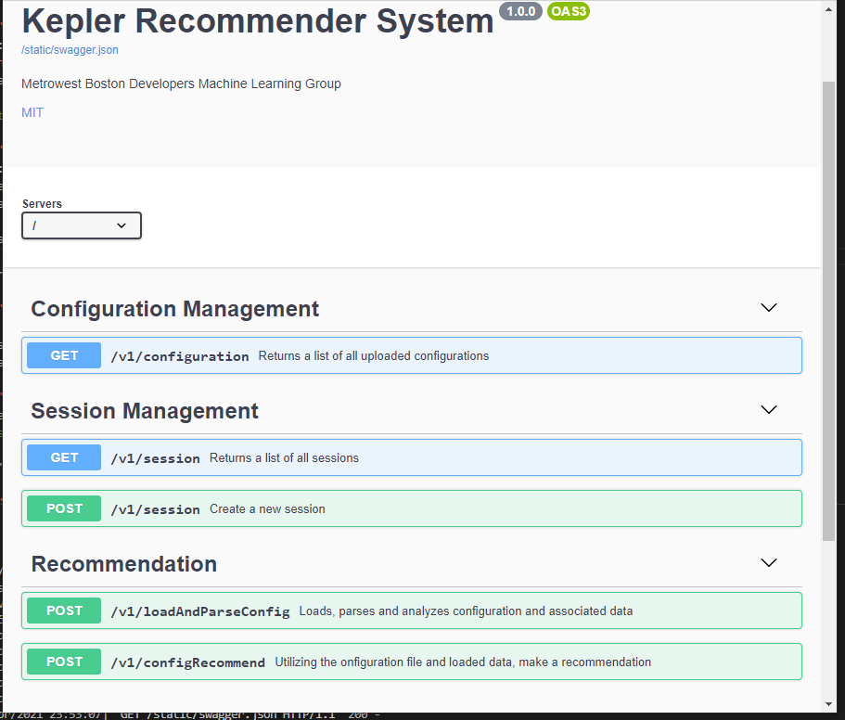
swagger

Slide 10


Rest and sessions
The REST protocol, based on HTTP is stateless.
The Kepler recommendation engine supports multiple, simultaneous, recommendation configurations. Each contained within its own session.
US Movie
DB
SessionId
"e41860f3ff3c450ea61fcd5d9d9f5428"
TEDTalk
DB
SessionId
"33713b9c77594113ac517989396e4249"

Slide 11
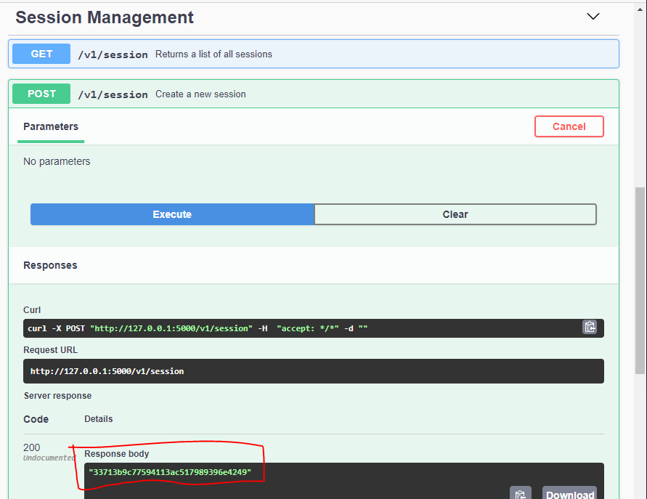
Create a Session

Slide 12
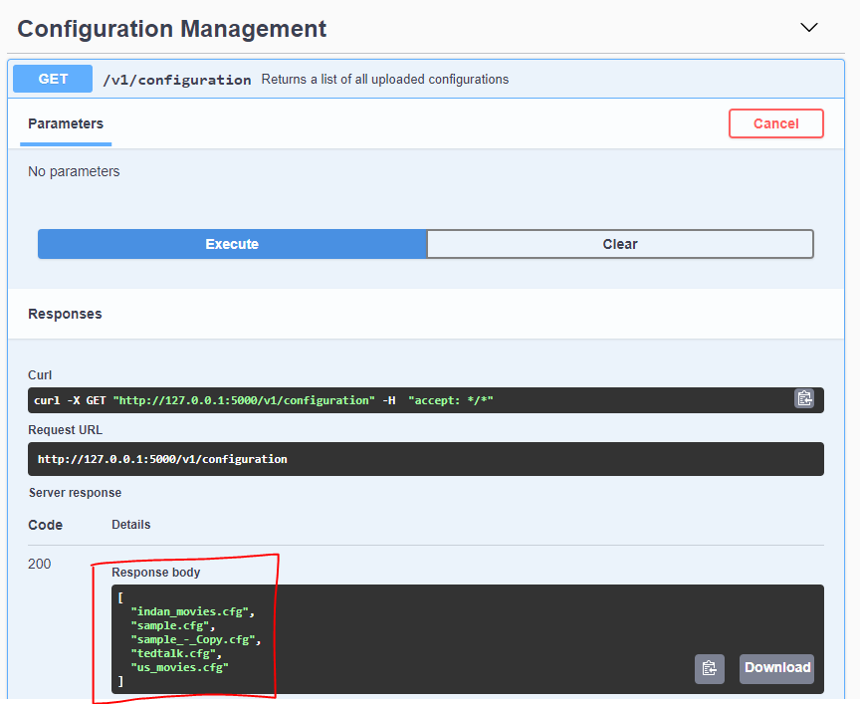
List Available Configurations

Slide 13
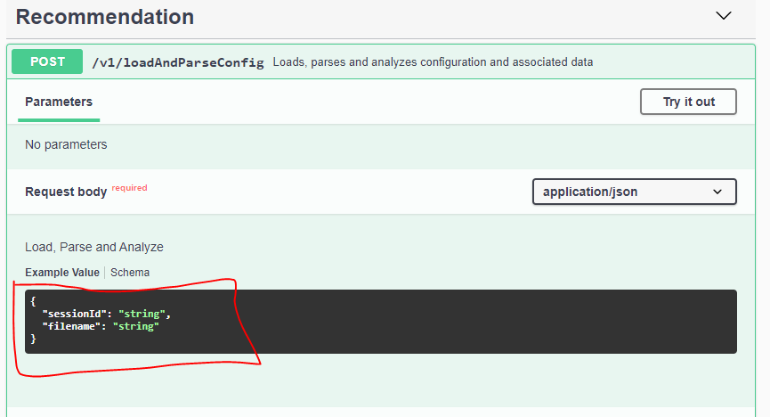
Load and Parse schema

Slide 14
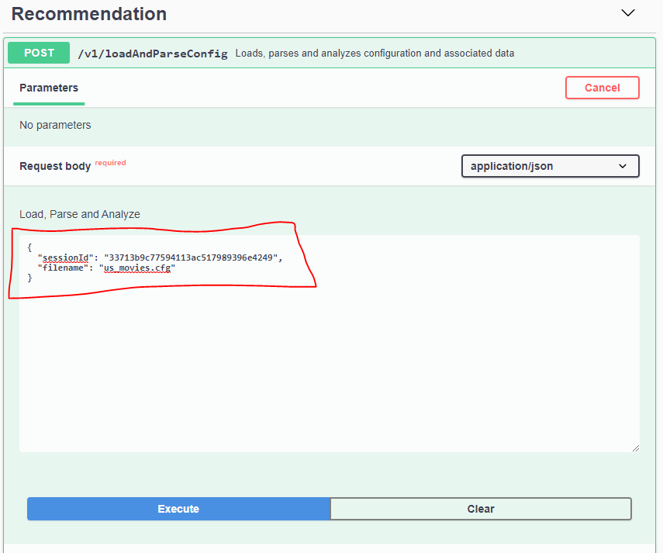
Load and Parse Example

Slide 15
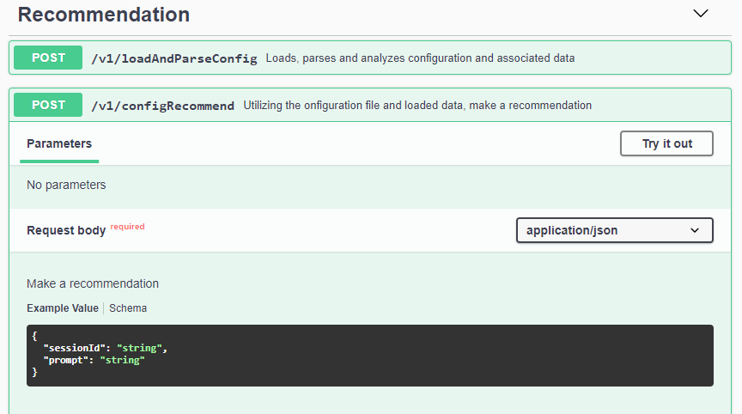
Recommendation Schema

Slide 16
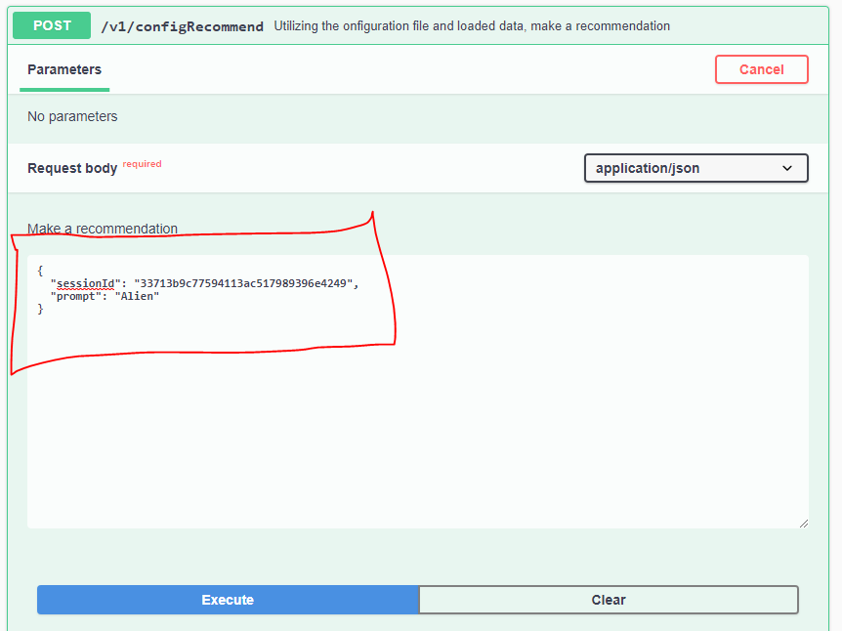
Recommendation Example

Slide 17
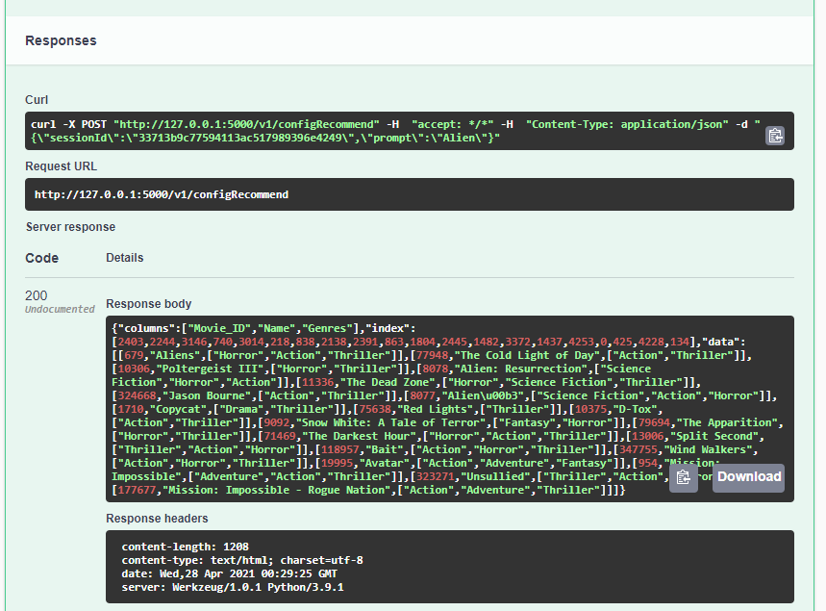
Recommendation Results

